Slide 1
Block Diagrams for the Asynchronous SAR ADC
8-bit

Slide 2
General SAR ADC (synchronous)
clk
clk
clk
Digital Code
V
Sample-And-Hold
IN
SAR Logic
Comparator
clk
N-bit
DAC

Slide 3
➔ SAR ADC operation
V
X
V
+
V
4C
2C
C
C
CM
C
IN
V
_
OUT
V
V
V
X
X
X
X
4C
2C
C
C
S
V
4C
2C
C
C
4C
2C
C
C
4C
2C
C
C
(Dummy)
CM
V
D .
V
D .
V
V
V
D .
Ref
Ref
Ref
Ref
V
Ref
2
2
Ref
V
S
S
S
S
S
S
S
S
1
IN
From SAR logic
D2
D1
D0
V
V
D2
D1
D0
X
Ref
V
4C
2C
C
C
CM
D .
V
D .
V
D .
Ref
Ref
V
2
1
Ref
0
V
Ref
111
110
111
If Vin > Vref, Comp_out = 1
111
110
V
110
IN
101
101
110
101
V
100
V
101
If Vin > Vref, Comp_out = 1
If Vin > Vref, Comp_out = 0
101
100
Ref
DAC
100
2
100
011
011
If Vin > Vref, Comp_out = 0
If Vin > Vref, Comp_out = 1
011
010
010
010
001
If Vin > Vref, Comp_out = 1
If Vin < Vref, Comp_out = 0
If Vin > Vref, Comp_out = 1
001
If Vin > Vref, Comp_out = 0
001
000
0
000
Comparison 1
Comparison 2
Comparison 3
Comparison 1
Comparison 2
Comparison 3
Final Output

Slide 4
➔ SAR ADC operation
V
+
CM
C
V
_
OUT
X
4C
2C
C
C
S
V
(Dummy)
CM
V
S
S
S
S
S
S
S
S
IN
From SAR logic
V
D2
D2
D1
D1
D0
D0
Ref
V
V
CM
Refp
V
Refn
D7
D7
D6
D6
D5
D5
D4
D4
D3
D3
D2
D2
D1
D1
D0
D0
V
IN
S
S
S
S
S
S
S
S
S
S
S
S
S
S
S
S
S
S
V
128C
64C
32C
16C
8C
4C
2C
C
C
CM
(Dummy)
S
+
V
SAR Logic
XP
V
_
XN
128C
64C
32C
16C
8C
4C
2C
C
C
S
(Dummy)
V
V
S
S
S
S
S
S
S
S
S
S
S
S
S
S
S
S
S
S
CM
IN
V
D7
D7
D6
D6
D5
D5
D4
D4
D3
D3
D2
D2
D1
D1
D0
D0
Refp
V
Refn

Slide 5
➔ SAR ADC operation
External Clk
Clk_Sample
Clk_SAR
Comparator output
DAC code
Ready
EOC
Reset Compare Reset Compare Reset Compare Reset Compare Reset Compare Reset Compare Reset Compare Reset Compare Reset
$10000000$ $D_{7}1000000$ $D_{7}D_{6}100000 D_{7}D_{6}D_{5}10000$ $D_{7}D_{6}D_{5}D_{4}1000$ $D_{7}D_{6}D_{5}D_{4}D_{3}100 D_{7}D_{6}D_{5}D_{4}D_{3}D_{2}10 D_{7}D_{6}D_{5}D_{4}D_{3}D_{2}D_{1}1 D_{7}D_{6}D_{5}D_{4}D_{3}D_{2}D_{1}D_{0}$

Slide 6
Asynchronous SAR ADC block diagram
Internal Clks
V
Internal Clock Generator
Clk_SAR
EXTERNAL CLK
Clk_Sample
Ready
EOC
V
EOC
IN
Sample-And-Hold
D
Asynchrounous SAR Logic
Output Register
OUT
Comparator
N-bit
DAC

Slide 7

Internal clock generator
clk_ext
Delay Cell
clk_sample
D
Q
0
1
0
1
clk_sar
Ready
Delay Cell
reset
Delay Cell
set
clk_sample
EOB

Slide 8
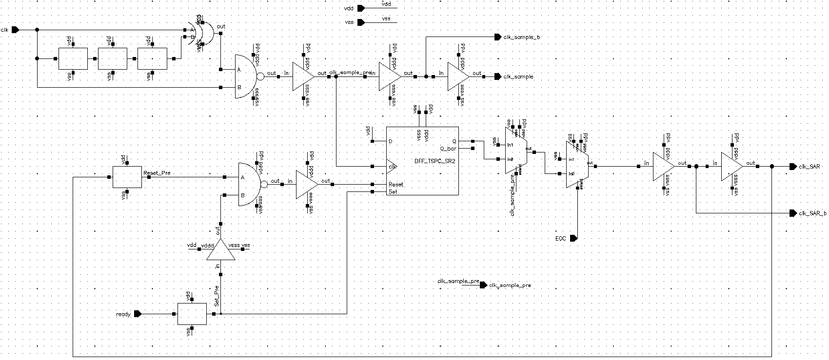
Internal clock generator
A
B
C

Slide 9
Internal clock generator (Part A)
External Clk
Delayed Clk
XOR output
AND output
(Clk_Sample)

Slide 10
Bootstrapped Switch
clkb
Mn2
Mp2
C
offset
clk
clkb
clkb
Mn1
Mp1
Mn3 Mn4
MnSW
Vin
Vout
MpSW
clkb

Slide 11
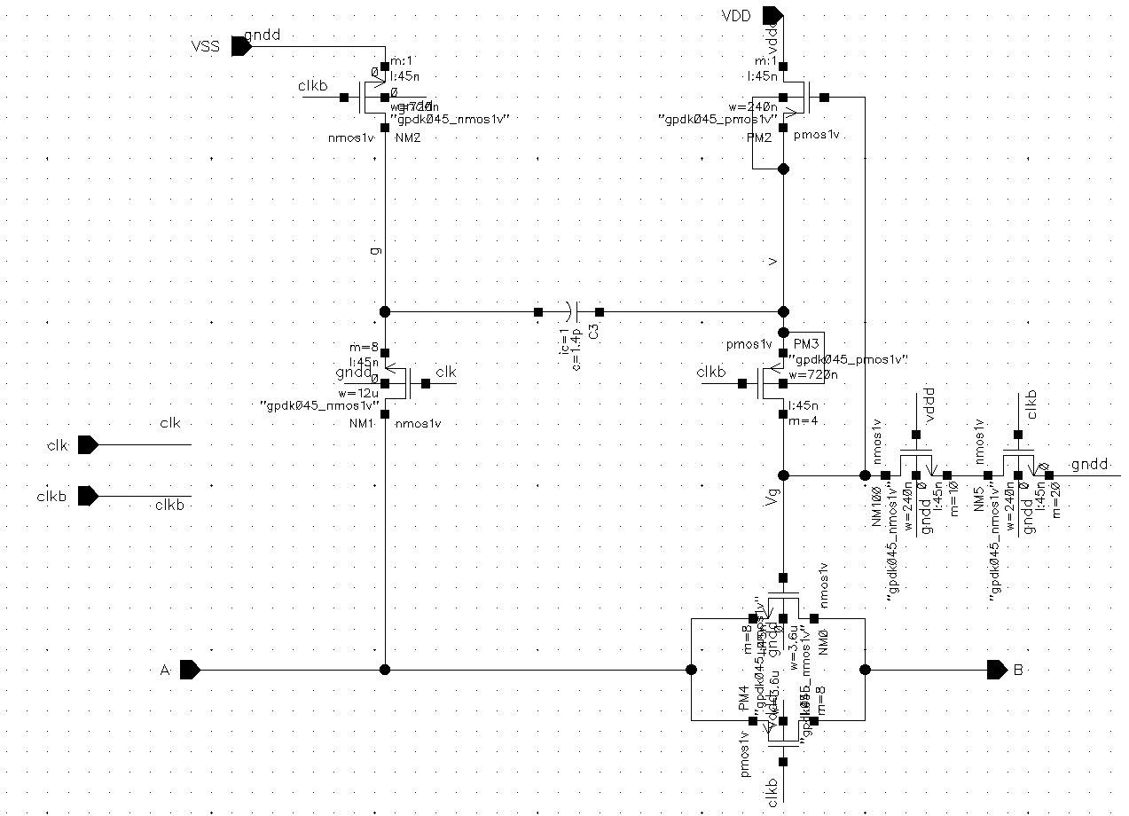
Bootstrapped Switch
Mn2
Mp2
C
offset
Mn3 Mn4
Mn1
Mp1
Vg
MnSW
Vs = Vin
MpSW

Slide 12
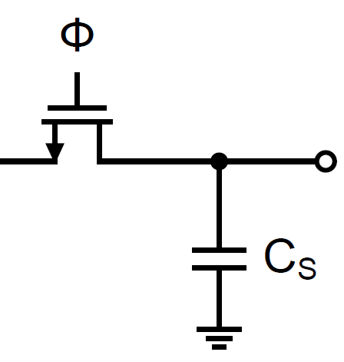
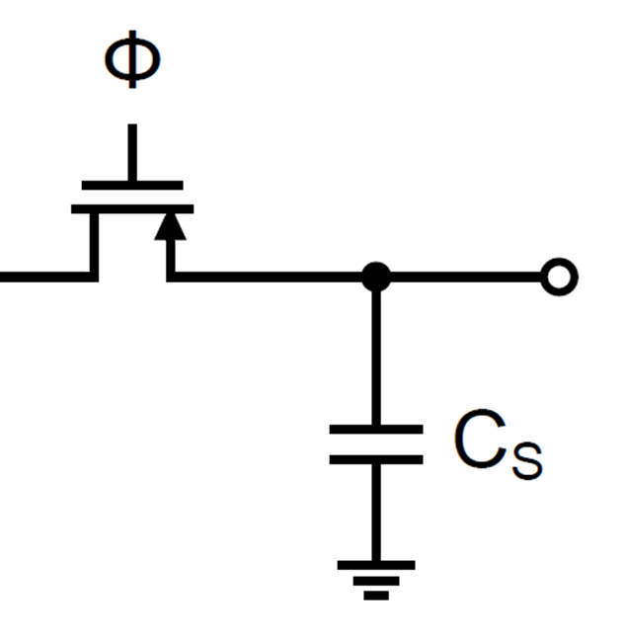
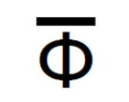
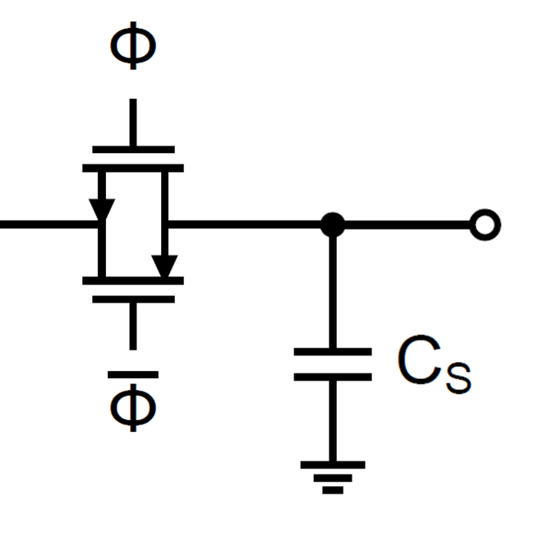
Bootstrapped Switch
Vin
Vout
Vin
Vout
Vin
Vout

Slide 13
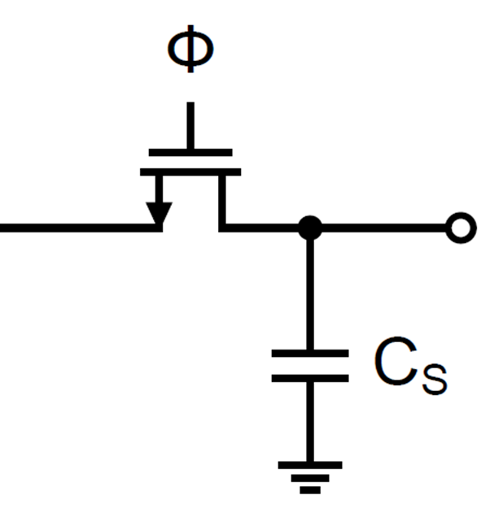
Bootstrapped Switch (non-idealities)
V
CLK
0
R
C
C
ON
GS
GD
Vin
Vout
Vin
Vout
Vin
Vout

Slide 14
Capacitive DAC
V
Refp
V
Refn
D7
D7
D6
D6
D5
D5
D4
D4
D3
D3
D2
D2
D1
D1
D0
D0
V
S
INn
S
S
S
S
S
S
S
S
S
S
S
S
S
S
S
S
S
S
Bootstrapped Switch
V
128C
64C
32C
16C
8C
4C
2C
C
C
CM
(Dummy)
S
V
XP
S
To the Comparator
V
XN
Bootstrapped Switch
128C
64C
32C
16C
8C
4C
2C
C
C
S
(Dummy)
V
V
S
S
S
S
S
S
S
S
S
S
S
S
S
S
S
S
S
S
CM
INp
S
V
D7
D7
D6
D6
D5
D5
D4
D4
D3
D3
D2
D2
D1
D1
D0
D0
Refp
V
Refn

Slide 15
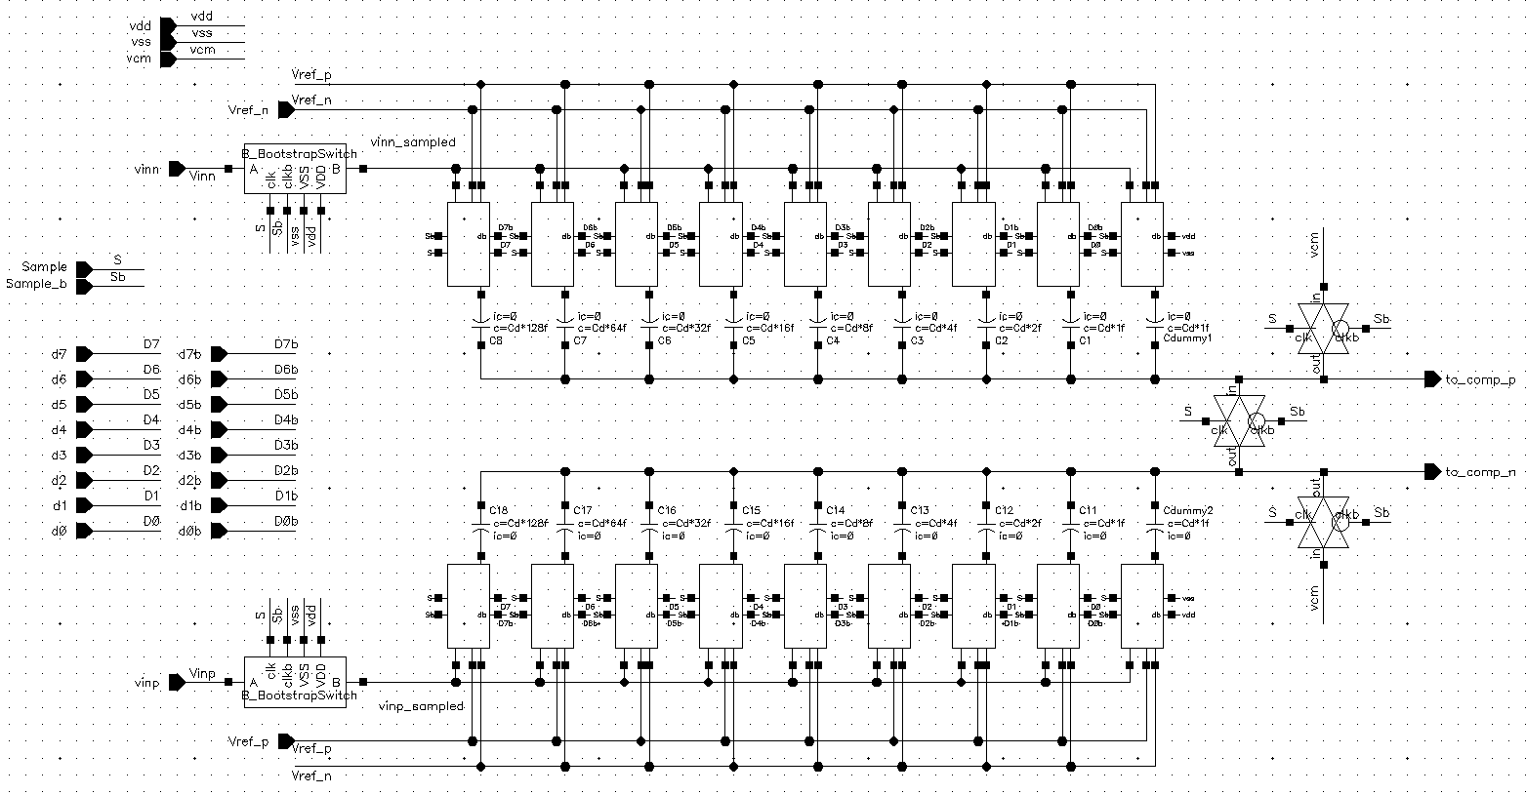
Capacitive DAC
Bootstrapped S/H circuit
Switch Network
Transmission Gate Switch

Slide 16
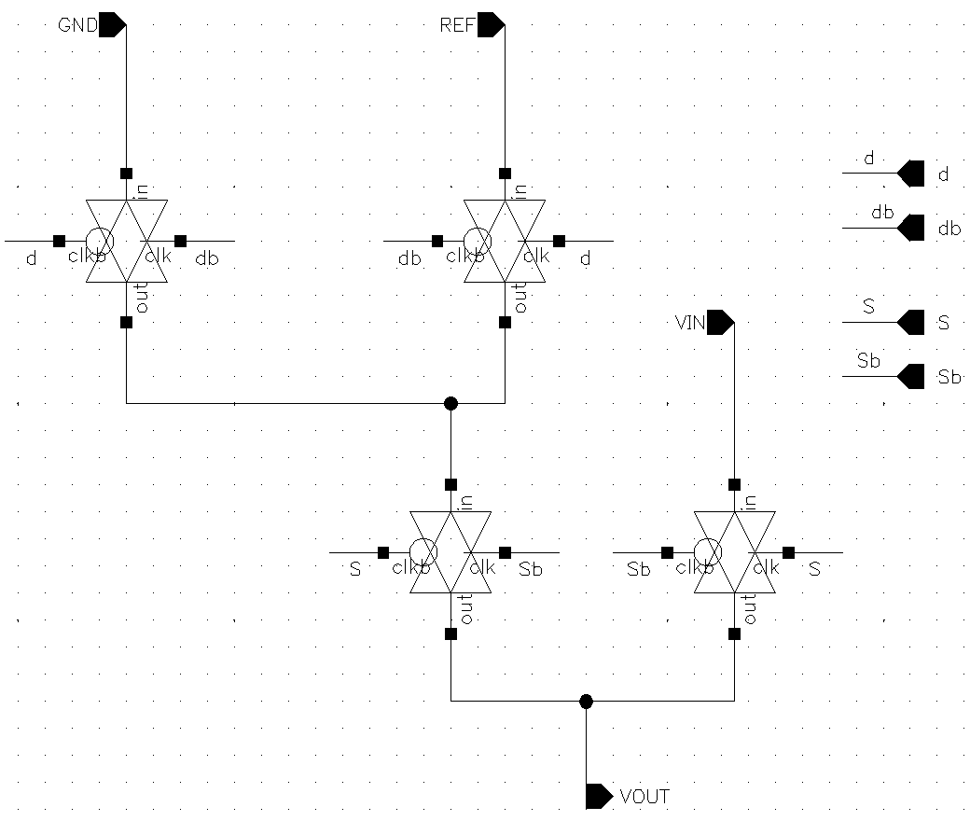
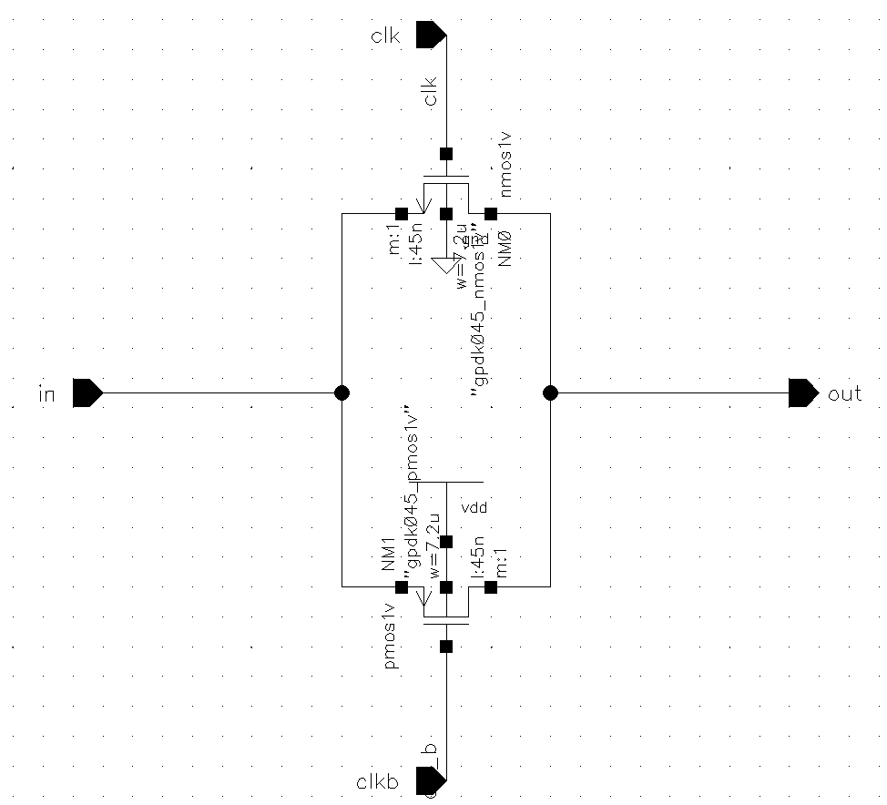
Capacitive DAC
Mn0
Mp0

Slide 17
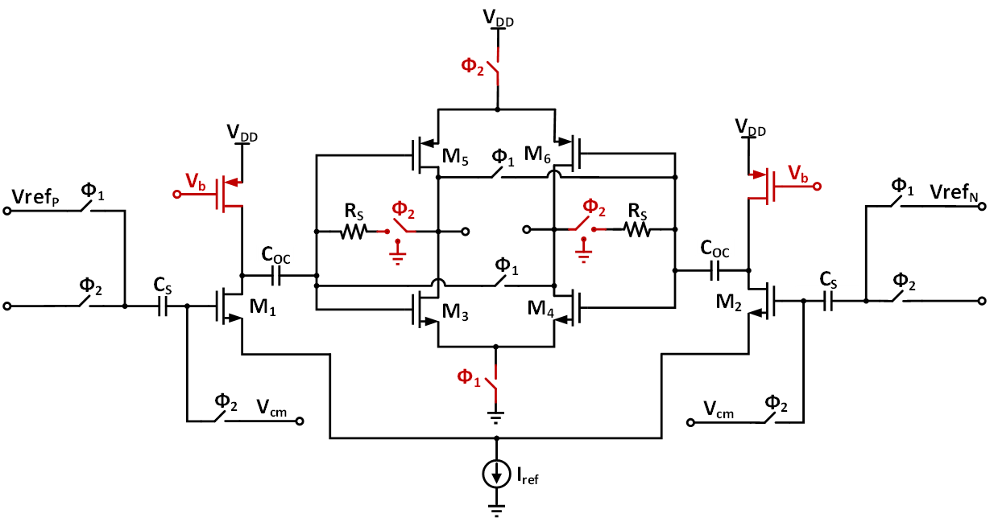
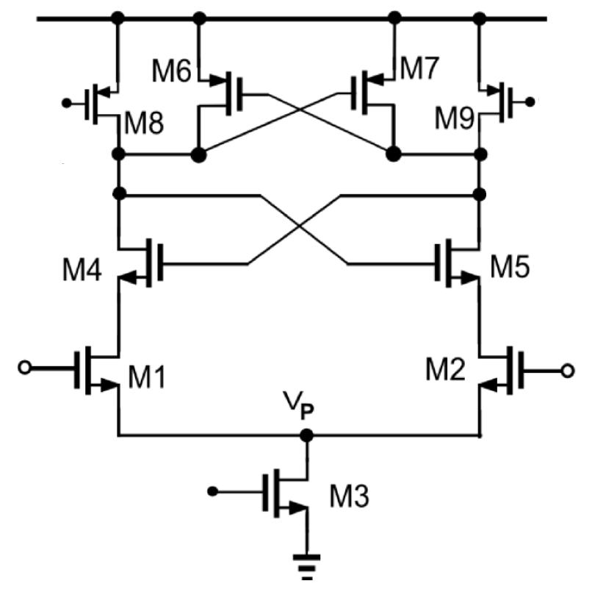
Comparator
VDD
clk
clk
out–
out+
out+
out–
in+
in–
in+
in–
clk

Slide 18
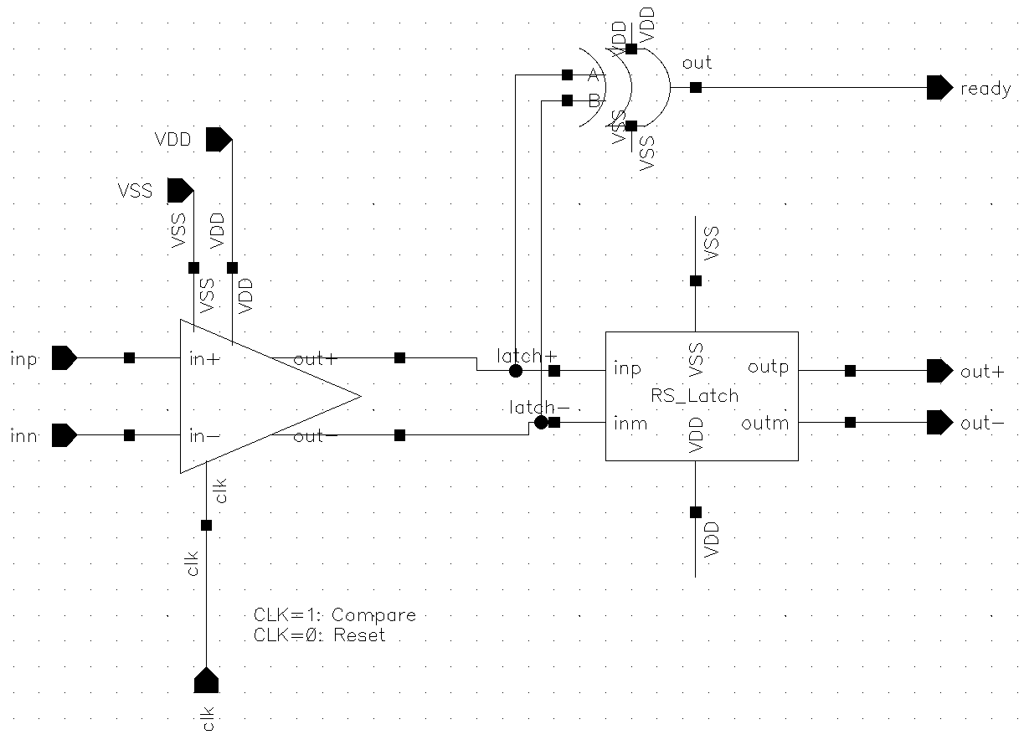
Comparator
XOR
StrongArm Comparator
RS Latch

Slide 19




XOR
Comparator
Ready
inp
+
+
+
+
outp
RS Latch
inn
–
–
–
–
outn
StrongArm Latch
$$V_{DD}$$
$$V_{DD}$$
clk
Mp3
Mp1
Mp2
Mp4
clk
$$V_{DD}$$
$$V_{DD}$$
out–
out+
out+
out–
in+
in–
Mn3
Mn4
in+
in–
Mn1
Mn2
clk
Mn_tail

Slide 20
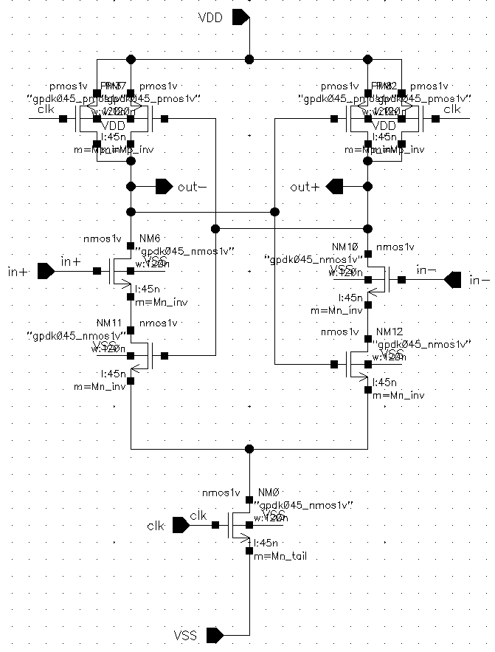
Comparator
Mp3
Mp1
Mp2
Mp4
Mn3
Mn4
Mn1
Mn2
Mn_tail

Slide 21
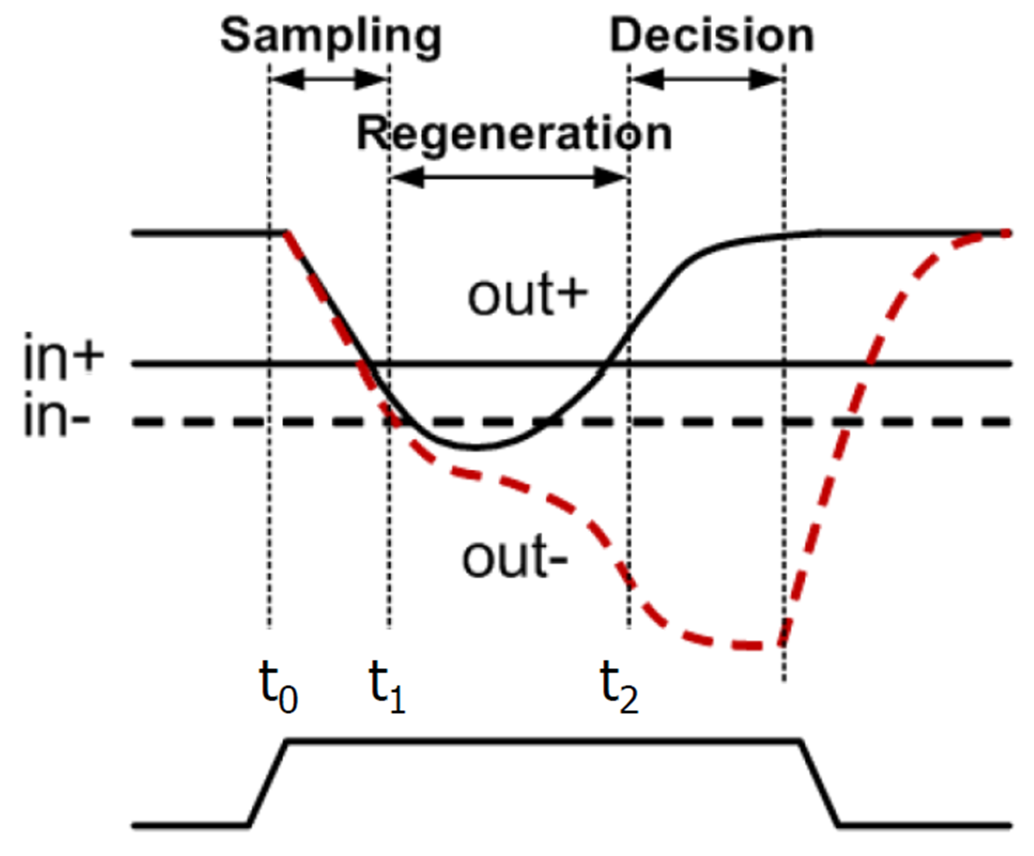
Comparator
Reset
Reset
Clk = 0
Clk = 1
Clk = 0

Slide 22
Comparator
Sampling
Decision
Reset
Regeneration
Reset
in+
Out+
in–
Out–
clk

Slide 23
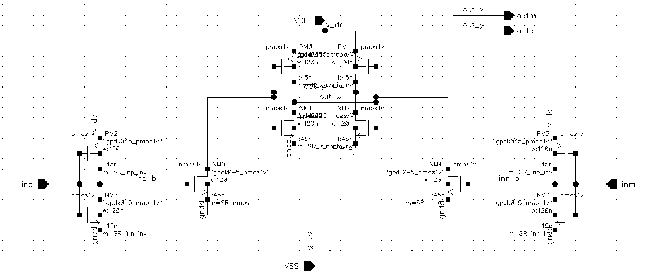
Comparator
M9
M10
M3
M7
M8
M4
M5
M6
M1
M2

Slide 24
Asynchronous SAR Logic
Sequencer Register
EOC
D
set
Q
D
set
Q
D
set
Q
D
set
Q
D
set
Q
D
set
Q
D
set
Q
D
set
Q
D
set
Q
D
set
Q
reset
reset
reset
reset
reset
reset
reset
reset
reset
reset
clk_sar
Comparator_out
D
set
Q
D
set
Q
D
set
Q
D
set
Q
D
set
Q
D
set
Q
D
set
Q
D
set
Q
D
set
Q
reset
reset
reset
reset
reset
reset
reset
reset
reset
Reset
D[7] D[6] D[5] D[4] D[3] D[2] D[1] D[0]
Code Register

Slide 25
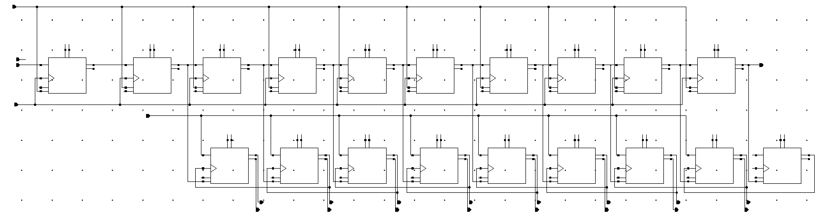
















Asynchronous SAR Logic
clk_sample (Reset)
VDD
GND
DFF_init
DFF7
DFF6
DFF5
DFF4
DFF3
DFF2
DFF1
DFF0
DFF_end
EOC
clk_sar
Comparator_out
DFFc7
DFFc6
DFFc5
DFFc4
DFFc3
DFFc2
DFFc1
DFFc0
DFFc_end
$$D_{7}$$
$$D_{6}$$
$$D_{5}$$
$$D_{4}$$
$$D_{3}$$
$$D_{2}$$
$$D_{1}$$
$$D_{0}$$
$$\overline{D_{7}}$$
$$\overline{D_{6}}$$
$$\overline{D_{5}}$$
$$\overline{D_{4}}$$
$$\overline{D_{3}}$$
$$\overline{D_{2}}$$
$$\overline{D_{1}}$$
$$\overline{D_{0}}$$

Slide 26
Asynchronous SAR Logic
 |  | Sequencer Register Outputs |  |  |  |  |  |  |  |  |  |  | Code Register Outputs |  |  |  |  |  |  |  |  | Comparator Output
 |  | DFF_init | DFF7 | DFF6 | DFF5 | DFF4 | DFF3 | DFF2 | DFF1 | DFF0 | DFF_end |  | DFFc7 | DFFc6 | DFFc5 | DFFc4 | DFFc3 | DFFc2 | DFFc1 | DFFc0 | DFFc_end | Comp_out
0 | Sampling | 1 | 0 | 0 | 0 | 0 | 0 | 0 | 0 | 0 | 0 |  | 0 | 0 | 0 | 0 | 0 | 0 | 0 | 0 | 0 | X
1 | Comparison 1 | 0 | 1 | 0 | 0 | 0 | 0 | 0 | 0 | 0 | 0 |  | 1 | 0 | 0 | 0 | 0 | 0 | 0 | 0 | 0 | B7
2 | Comparison 2 | 0 | 0 | 1 | 0 | 0 | 0 | 0 | 0 | 0 | 0 |  | B7 | 1 | 0 | 0 | 0 | 0 | 0 | 0 | 0 | B6
3 | Comparison 3 | 0 | 0 | 0 | 1 | 0 | 0 | 0 | 0 | 0 | 0 |  | B7 | B6 | 1 | 0 | 0 | 0 | 0 | 0 | 0 | B5
4 | Comparison 4 | 0 | 0 | 0 | 0 | 1 | 0 | 0 | 0 | 0 | 0 |  | B7 | B6 | B5 | 1 | 0 | 0 | 0 | 0 | 0 | B4
5 | Comparison 5 | 0 | 0 | 0 | 0 | 0 | 1 | 0 | 0 | 0 | 0 |  | B7 | B6 | B5 | B4 | 1 | 0 | 0 | 0 | 0 | B3
6 | Comparison 6 | 0 | 0 | 0 | 0 | 0 | 0 | 1 | 0 | 0 | 0 |  | B7 | B6 | B5 | B4 | B3 | 1 | 0 | 0 | 0 | B2
7 | Comparison 7 | 0 | 0 | 0 | 0 | 0 | 0 | 0 | 1 | 0 | 0 |  | B7 | B6 | B5 | B4 | B3 | B2 | 1 | 0 | 0 | B1
8 | Comparison 8 | 0 | 0 | 0 | 0 | 0 | 0 | 0 | 0 | 1 | 0 |  | B7 | B6 | B5 | B4 | B3 | B2 | B1 | 1 | 0 | B0
9 | Final Output | 0 | 0 | 0 | 0 | 0 | 0 | 0 | 0 | 0 | 1 |  | B7 | B6 | B5 | B4 | B3 | B2 | B1 | B0 | 1 | X
 |  |  |  |  |  |  |  |  |  |  | EOC

Slide 27
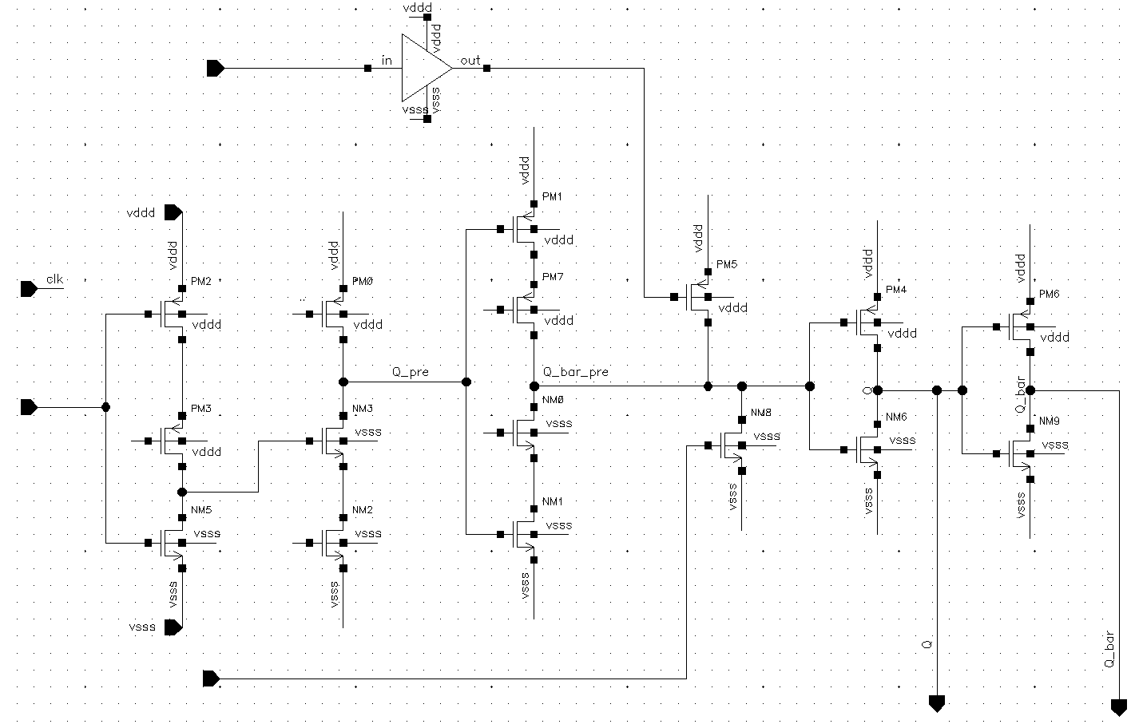
Asynchronous SAR Logic (TSPC)
Reset
M10
Clk
Set
Clk
M3
M6
M9
M12
D
Clk
Clk
M2
M5
M8
M11
Clk
M4
M7
M1
Set
Q
Q_bar

Slide 28




Asynchronous SAR Logic (TSPC)
$$V_{DD}$$
$$V_{DD}$$
$$V_{DD}$$
$$V_{DD}$$
clk
Set
Reset
D
clk
clk
Set
clk
Q
Q_bar

Slide 29
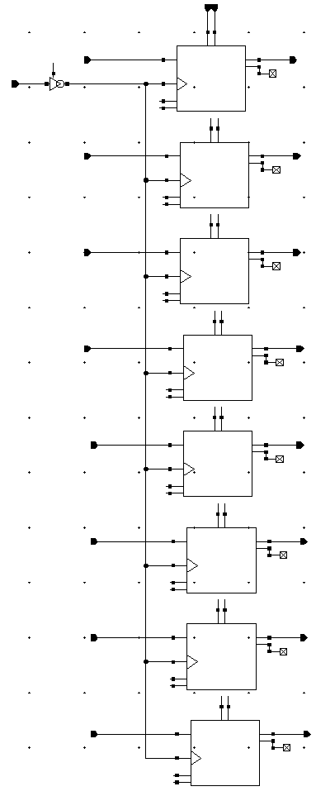
D7
Output Register
O7
EOC
D6
O6
D5
O5
D4
O4
D3
O3
D2
O2
D1
O1
D0
O0

Slide 30
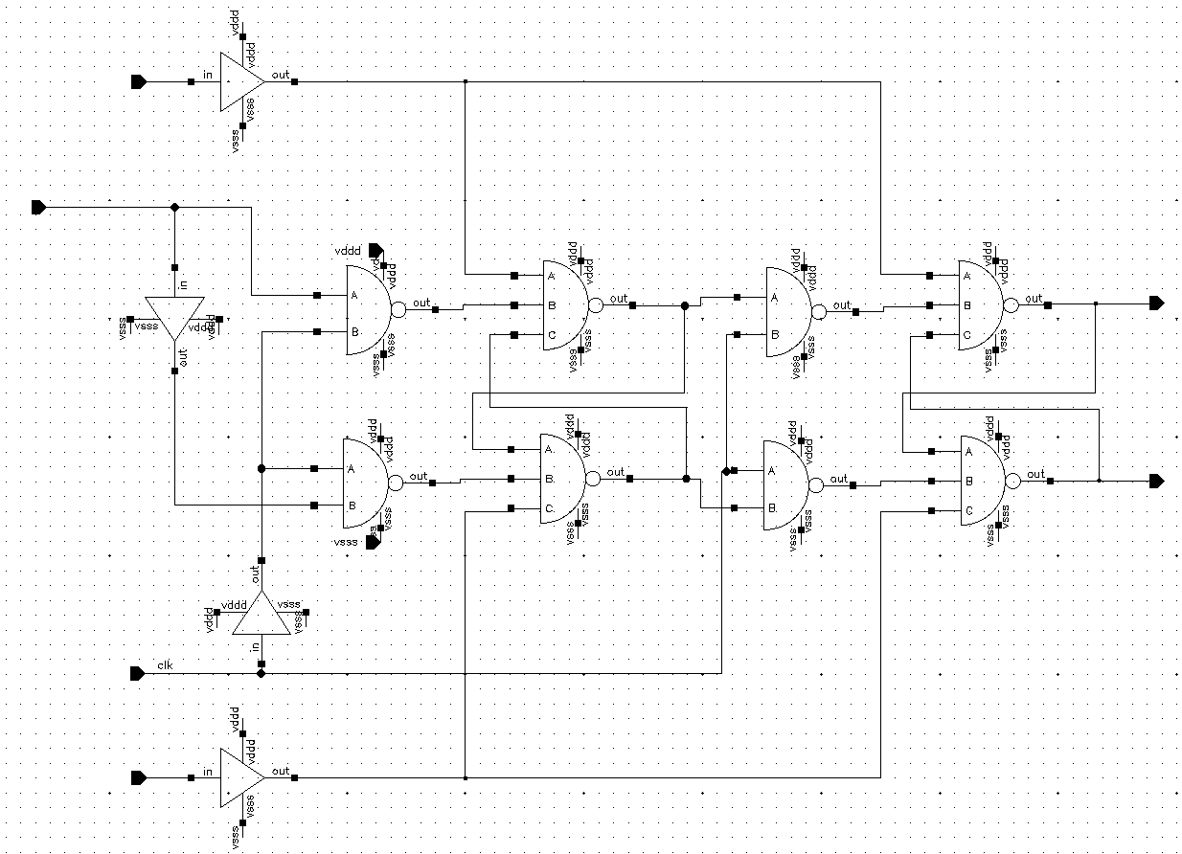
Output Register
Set
D
Q
Q_bar
Clk
Reset

Slide 31
Whole System Testbench

Slide 32
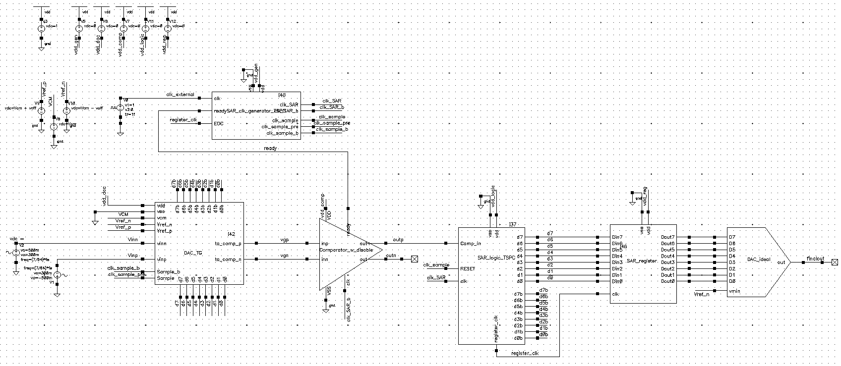
SAR ADC

Slide 33
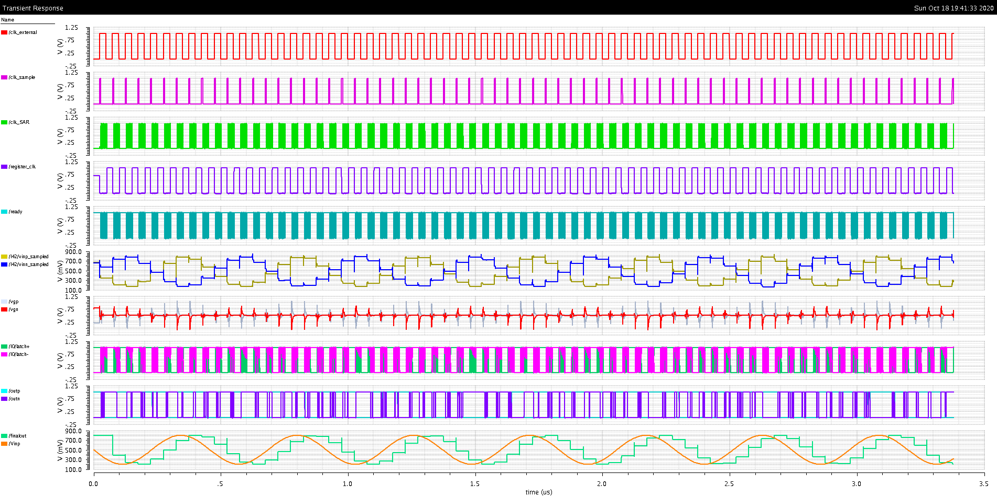
clk_external
clk_sample
clk_SAR
register_clk
ready
vinp_sampled
vinn_sampled
vgp
vgn
latch+
latch–
outp
outn
finalout
Vinp

Slide 34
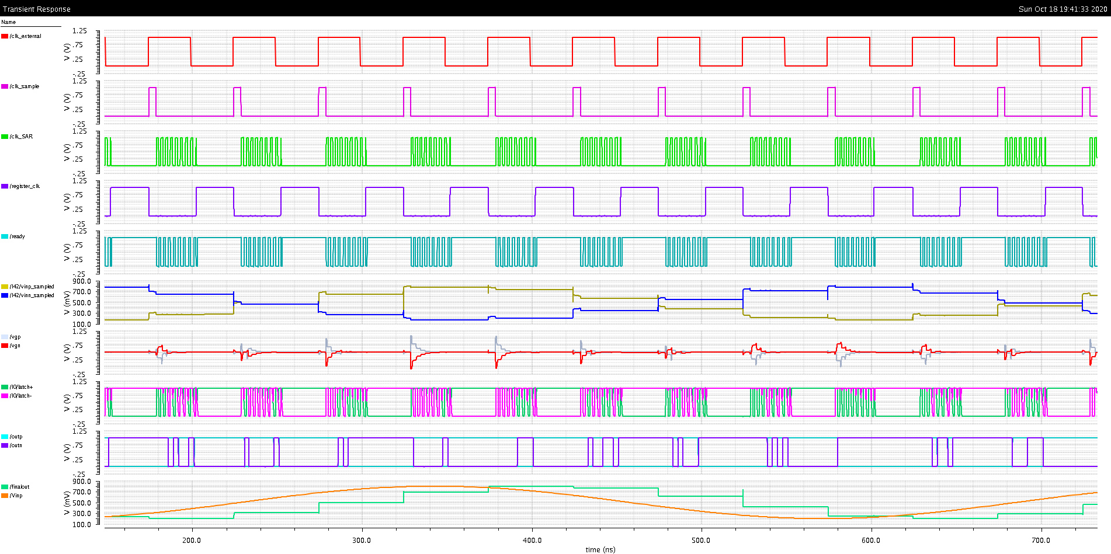
clk_external
clk_sample
clk_SAR
register_clk
ready
vinp_sampled
vinn_sampled
vgp
vgn
latch+
latch–
outp
outn
finalout
Vinp

Slide 35
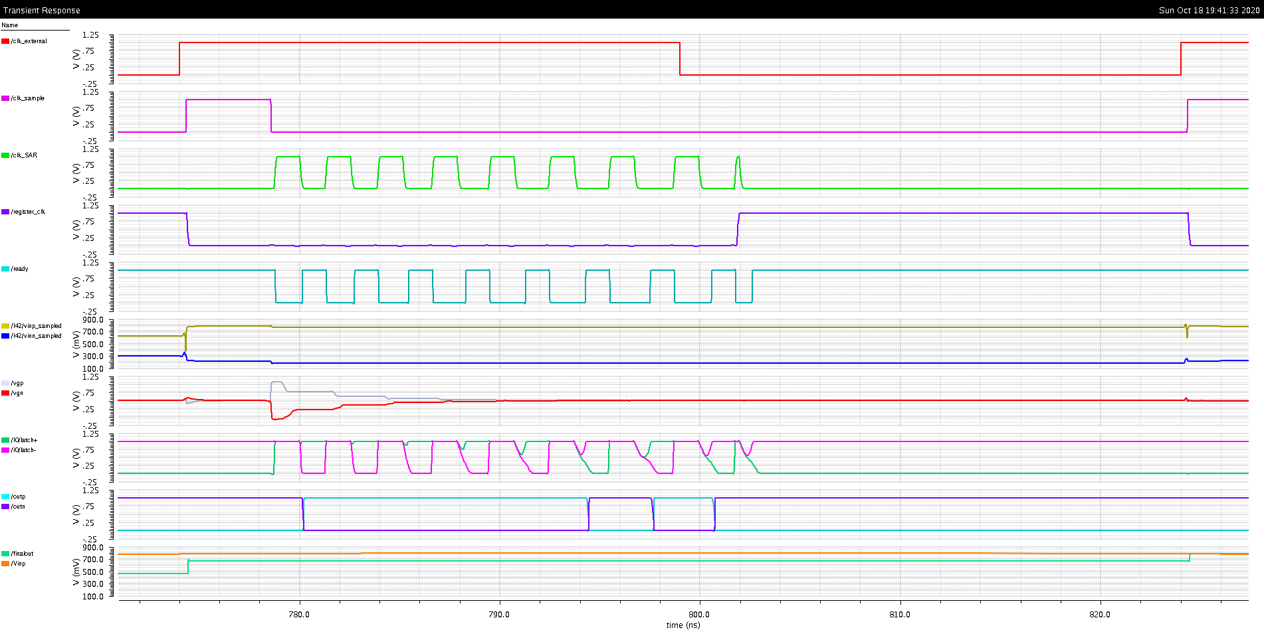
clk_external
clk_sample
clk_SAR
register_clk
ready
vinp_sampled
vinn_sampled
vgp
vgn
latch+
latch–
outp
outn
finalout
Vinp

Slide 36
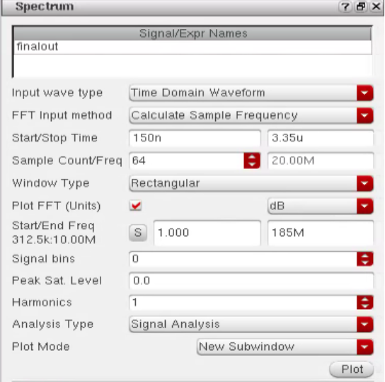

Slide 37
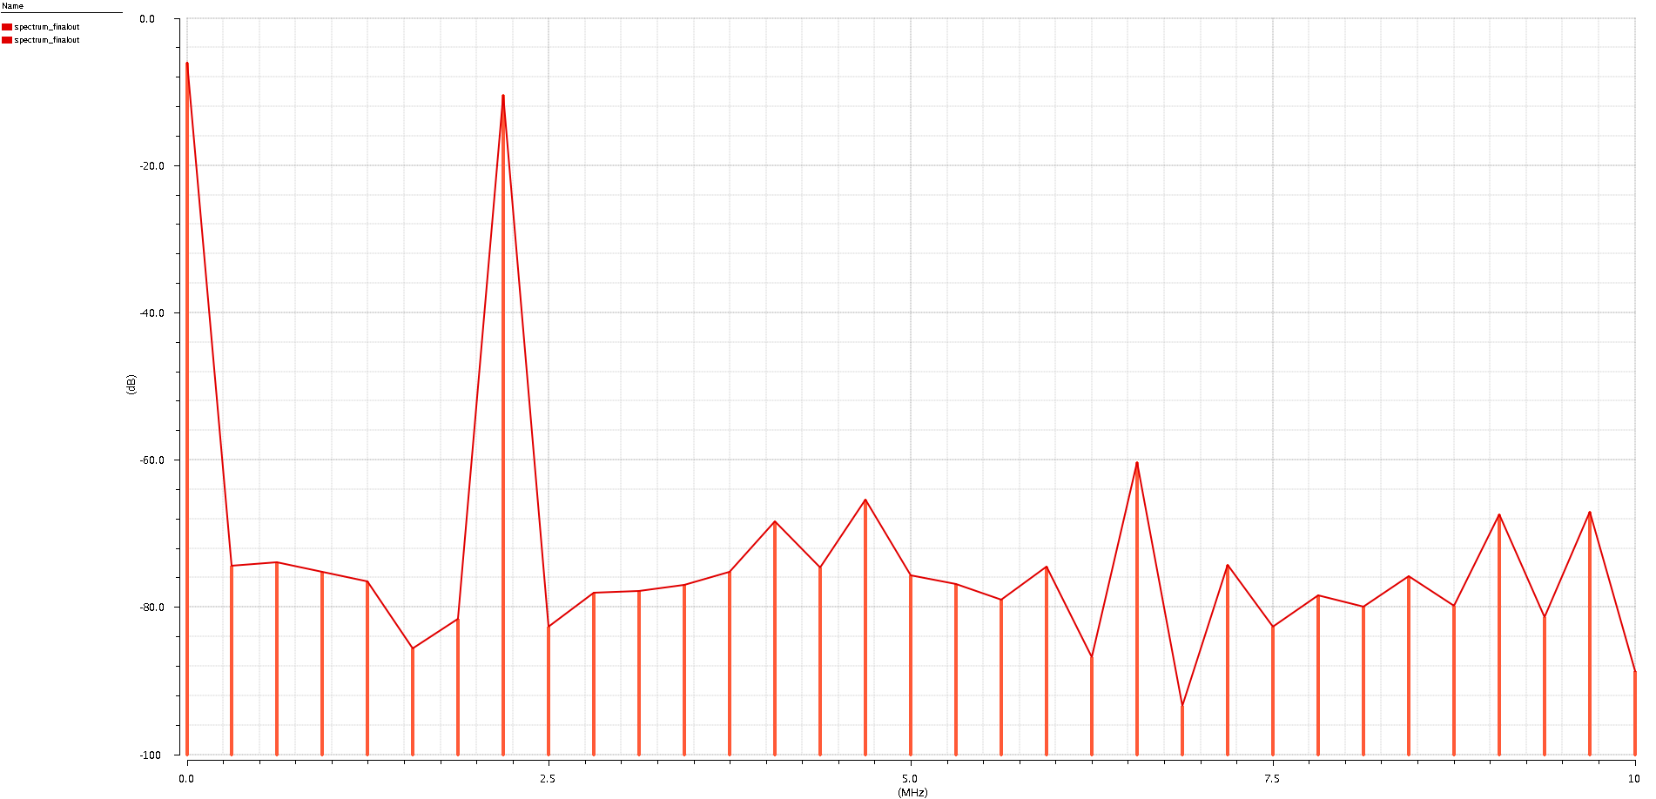
Spectrum of
finalout

Slide 39
RST_in
20ns
Time between RST pulses
20ns

